Slide 1
COMP 208 Midterm
Review Session

Slide 2
Who is this guy?
Shabbir Hussain
U4 Electrical Engineering
Engineering Peer tutor for Computer Science
epts.comp@mcgilleus.ca

Slide 3
How Should I Study for this?
Do past midterms
Start by doing the hardest questions first
Test your code on the computer
Make a cheat sheet (for yourself)

Slide 4
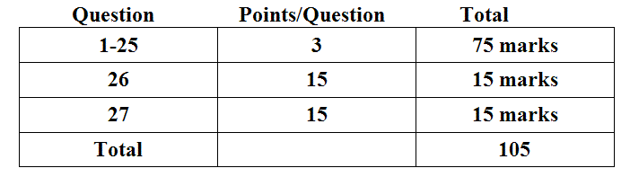
Look at the Grades Breakdown
Warm ups & worked Problems
Programming question
Another Programming question

Slide 5
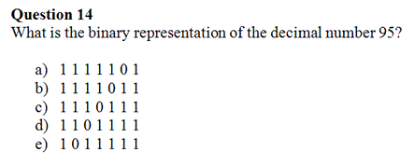
Warm Up with Binary numbers
Post answer at http://tinyurl.com/comp208

Slide 6
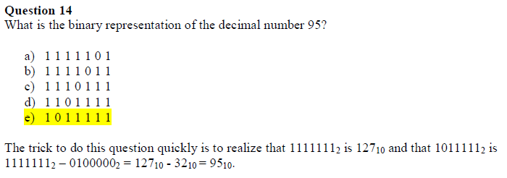
Warm Up with Binary numbers
Post answer at http://tinyurl.com/comp208

Slide 7

Types and Variables
Int – Holds integer Whole numbers
Float – Holds rational numbers
Char – Holds a character

Slide 8
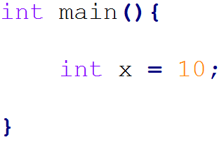
Types and Variables
10
X

Slide 9
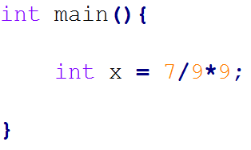
Expressions and Types
0
X
Expressions are evaluated Left to right

Slide 10
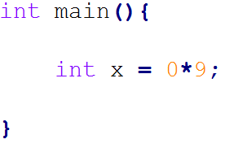
Expressions and Types
0
X

Slide 11
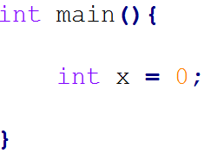
Expressions and Types
0
X

Slide 12
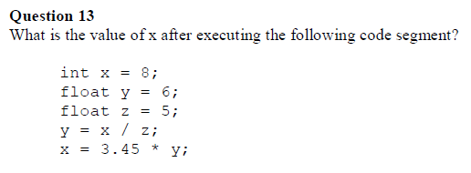
Expressions

Slide 13
Expressions
Answer is 5

Slide 14
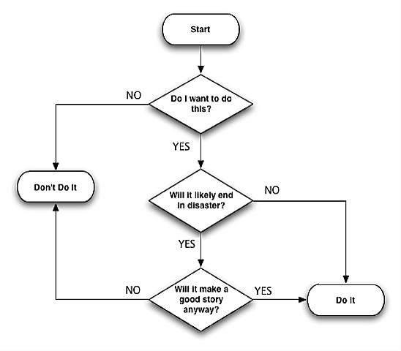
Flow Control
conditional variables: 1 for True or 0 for False
operators <, >, <=,>=, &&, ||

Slide 15
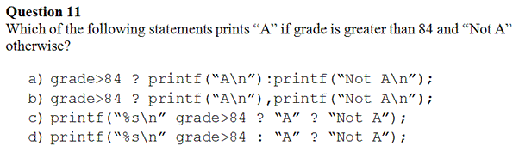
Flow Control

Slide 16
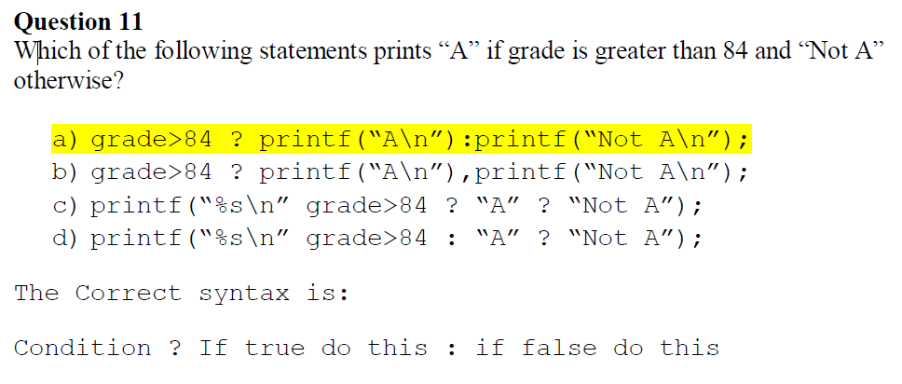
Flow Control

Slide 17
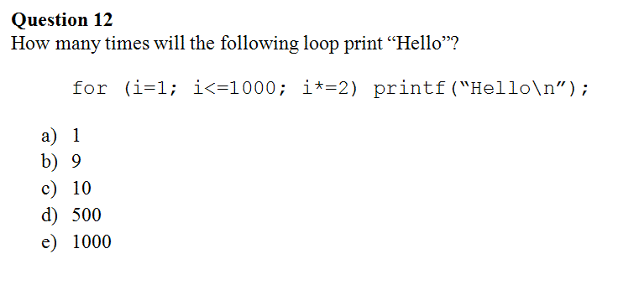
Flow Control

Slide 18
Flow Control
Iteration | Value of i | Is Hello Printed | New Value of I | Is Condition True
1 | 1 | Yes | 2 | Yes
2 | 2 | Yes | 4 | Yes
3 | 4 | Yes | 8 | Yes
 | … | Yes | … | Yes
10 | 512 | yes | 1024 | No
 | 1024 | No | - | -

Slide 19

Arrays
Arrays are a list of numbers. Great for processing things consistently.
s
34
56
60
S[0]
S[1]
S[2]

Slide 20
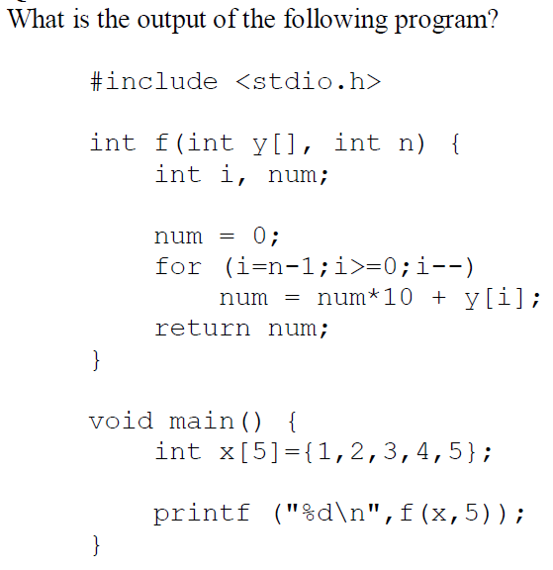
Arrays

Slide 21
Arrays
Iteration | i | num | Y[i]
1 | 4 | 5 | 5
2 | 3 | 54 | 4
3 | 2 | 543 | 3
4 | 1 | 5432 | 2
5 | 0 | 54321 | 1

Slide 22
Pointers
0
X
Address: &x

Slide 23
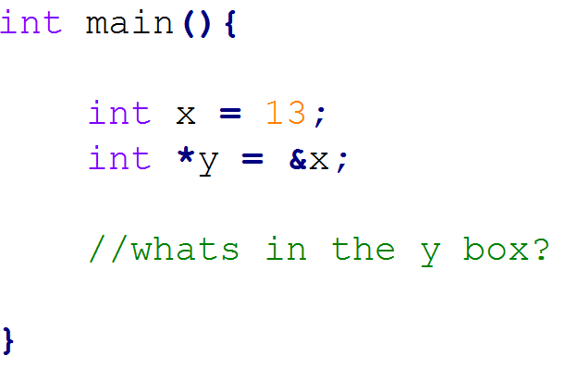
Pointers
Notes:
#include <stdio.h>
#include <string.h>
main(){
int x = 13;
int *y = &x;
printf("%d", y );
}

Slide 24
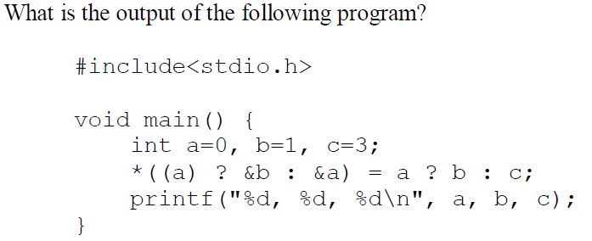
Pointers

Slide 25

Pointers
Output:

Slide 26
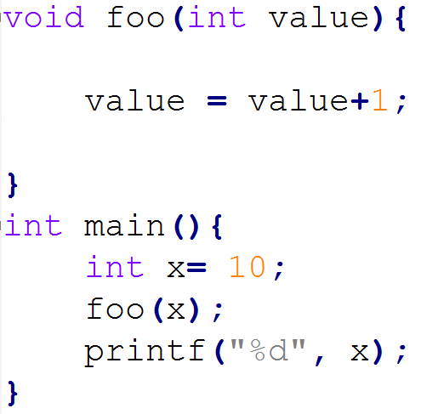
Using Pointers to pass Arguments
10
Passing by value:
X
Address: &x

Slide 27
Using Pointers to pass Arguments
10
10
Passing by value:
value
X
Address: &value
Address: &x

Slide 28
Using Pointers to pass Arguments
10
Passing by value:
X
Prints 10
Address: &x

Slide 29
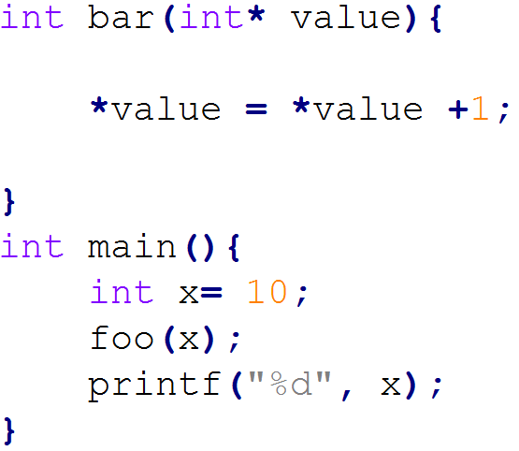
Using Pointers to pass Arguments
Passing by Reference:

Slide 30
Using Pointers to pass Arguments
10
Passing by reference:
*value
X
Address: &x aka value

Slide 31
Using Pointers to pass Arguments
Passing by Reference:
Prints 11

Slide 32
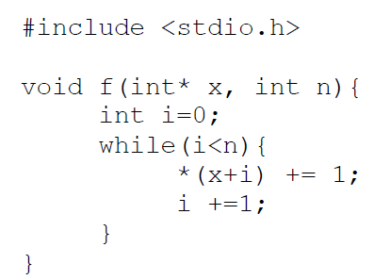
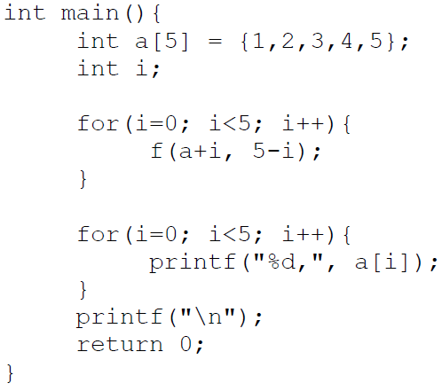
Using Pointers to pass Arguments

Slide 33

Using Pointers to pass Arguments
Answers:

Slide 34
Useful Links
Course Summary:
http://s3.amazonaws.com/docuum/attachments/2086/comp%20208%20info.pdf?1240285685
Run C code online:
http://codepad.org/
http://www.compileonline.com/compile_c_online.php
Scratchpad:
http://tinyurl.com/comp208

